Slide 1
WeChat as Gerontech: Towards Understanding Usability Issues of WeChat and Help Chinese Elders Keep in Touch with Their Family
Presented by
Changhao Li
Supervisor:
Prof Judy Kay and
Honorary A/Prof Bob Kummerfeld
Bachelor of Advanced Computing
Honours Thesis
Presentation and Defense

Slide 2
Motivation
Evidence from Reality:
The world is aging
Elders are less familiar with modern technology
Tendency for elders living alone
Pandemics might occur periodically

Slide 3
Motivation
Indication of Evidence:
- Will be more elders who find necessary modern technology for communication difficult to use
- Elders might be forced into situations such as lockdowns or self-isolations in future pandemics

Slide 4

Aim
To investigate and gain understanding of the ways and difficulties that elderly Chinese people use WeChat to keep in touch with the very small circle of their closest family members during pandemics.
Source: https://medium.com/swlh/wechat-the-evolution-and-future-of-chinas-most-popular-app-11effa5639ed

Slide 5
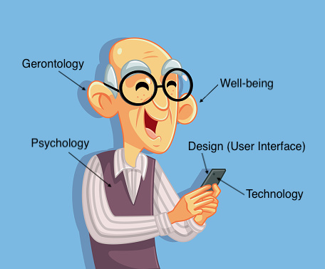
Conceptual Model

Slide 6
Research Questions
Q1. What are the “keep-in-touch” methods that are frequently used by Chinese elders?
Q2. What are the design issues with WeChat for elders to keep in touch?
Q3. How could we better design WeChat so that WeChat could better help elders keep in touch with family?
Q4. What are the commercial products’ effective design heuristics especially for elders to easily keep in touch?

Slide 7
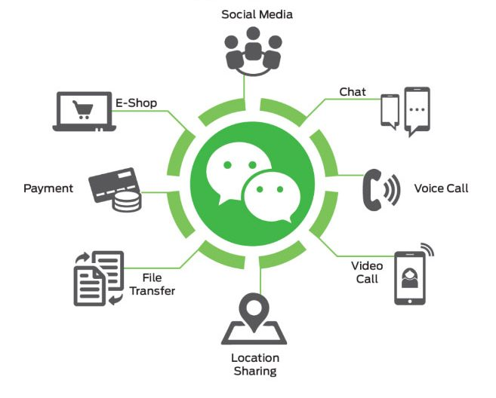
Background: WeChat
Source: https://www.fdichina.com/services/wechat-business-account/

Slide 8
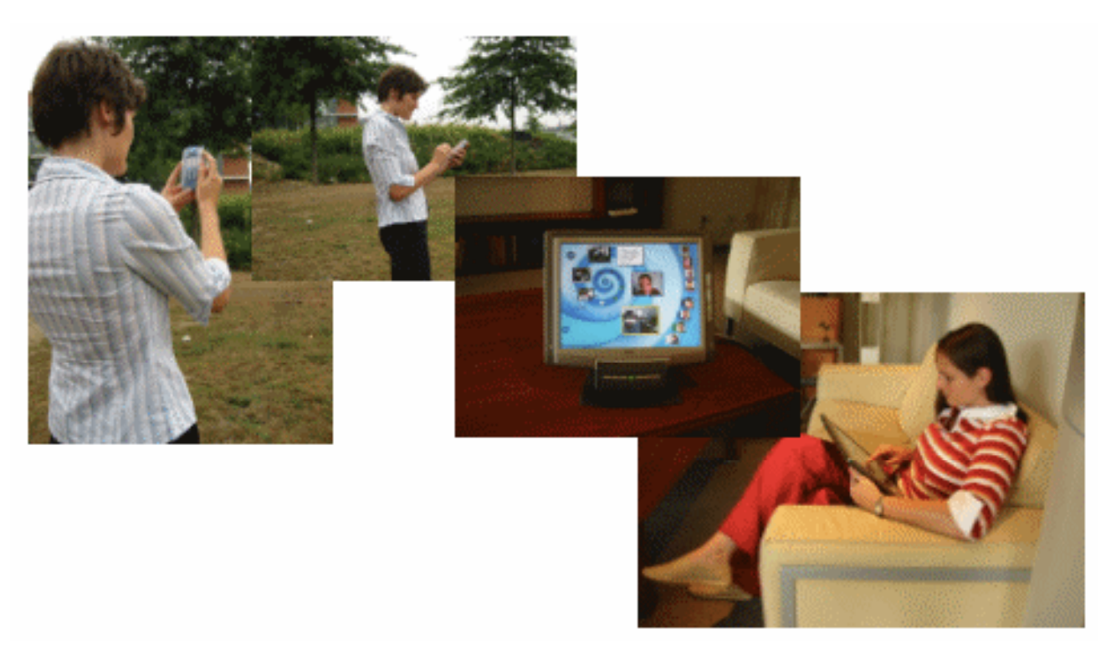
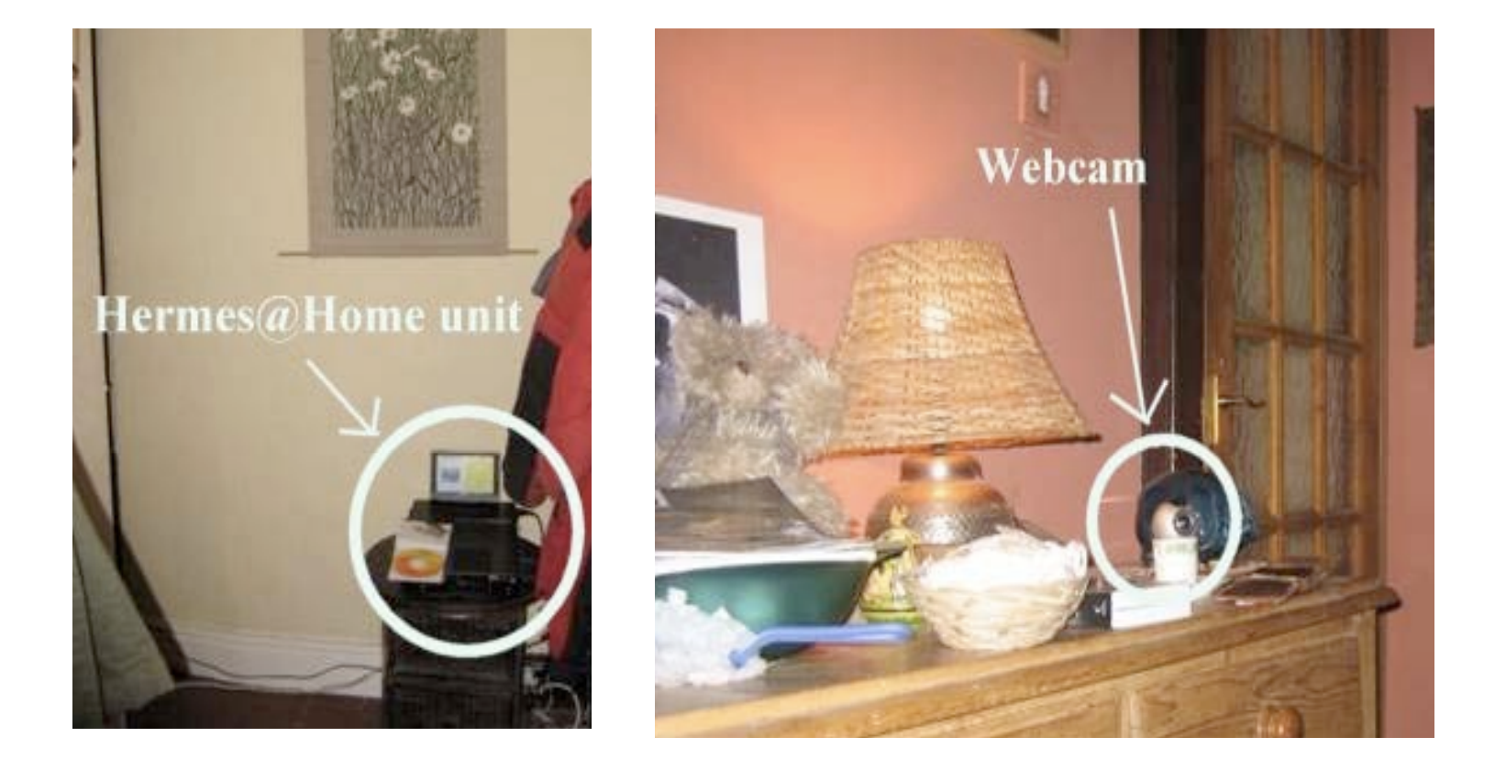
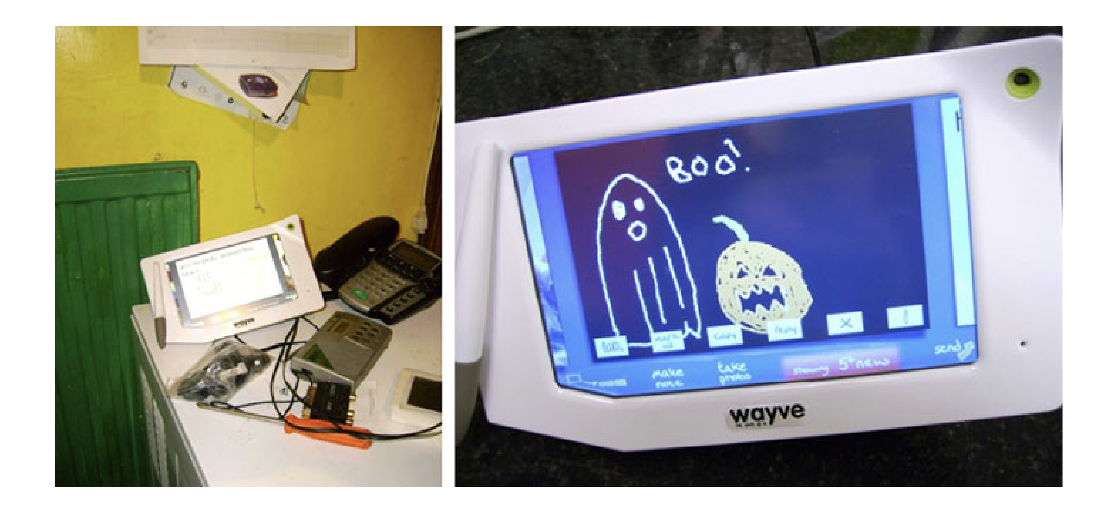
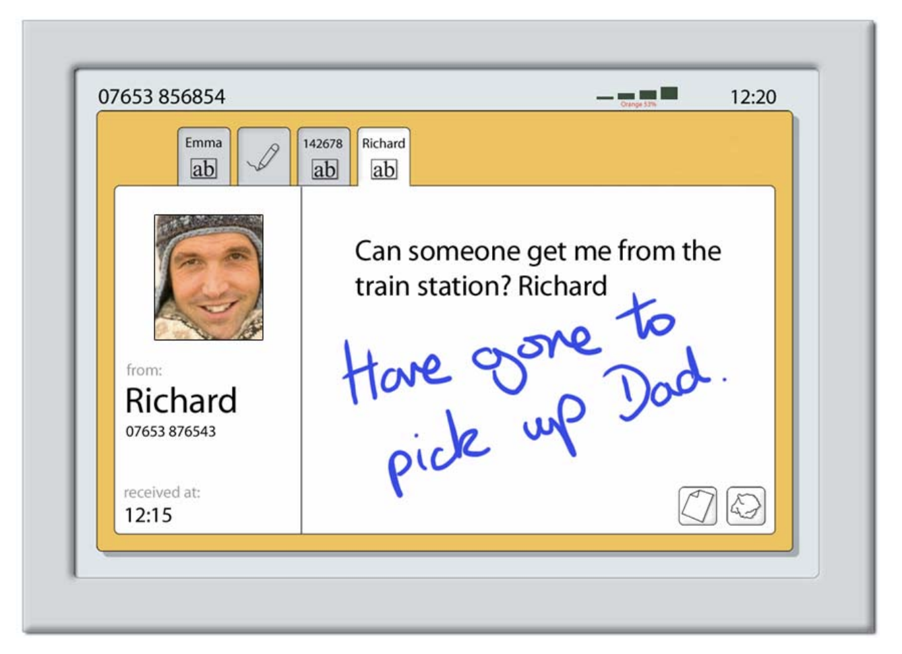
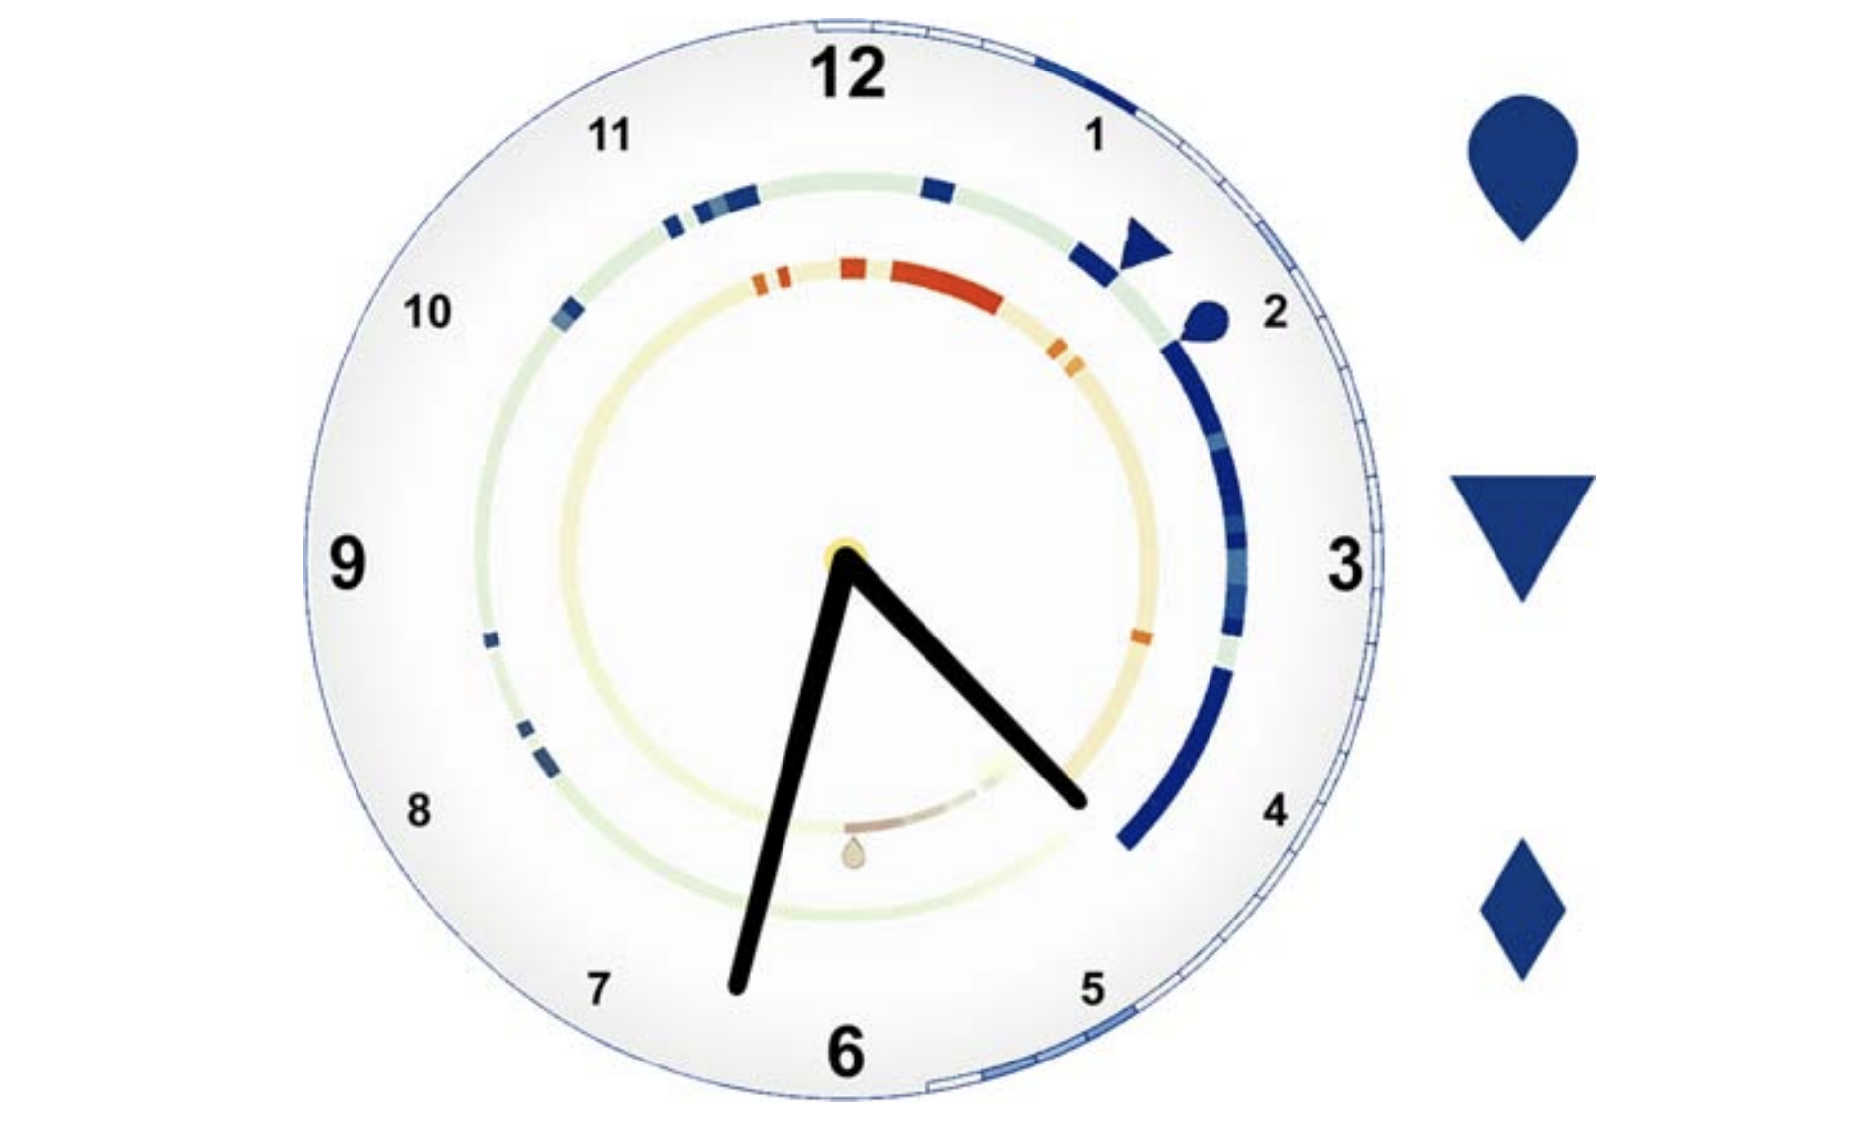
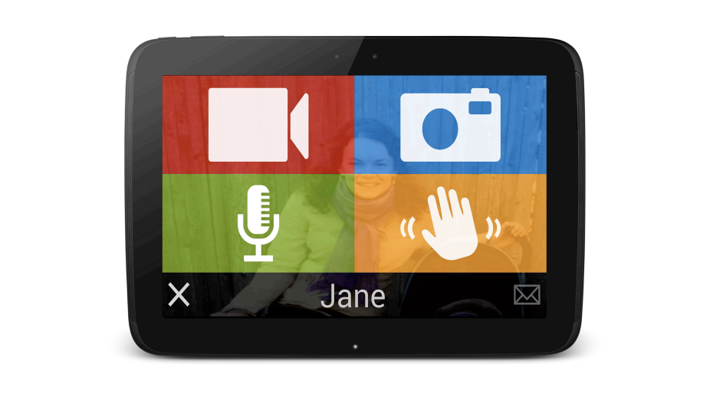
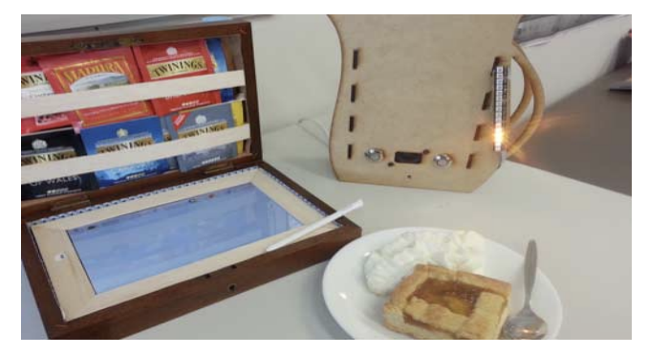
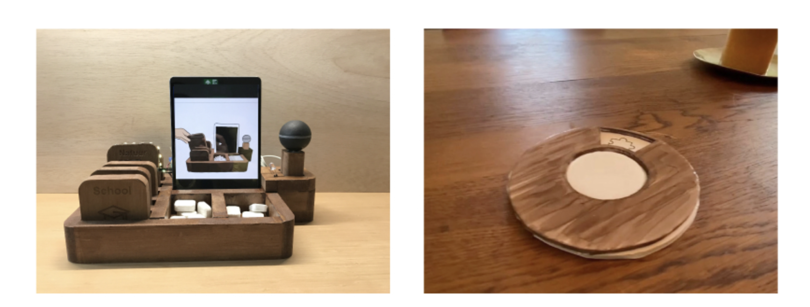
Literature Review
ASTRA (2004)
Hermes@Home (2006)
Wayve (2011)
HomeNote (2006)
MarkerClock (2009)
FIT (2014)
Messaging Kettle (2015)
CoasterChat (2021)

Slide 9
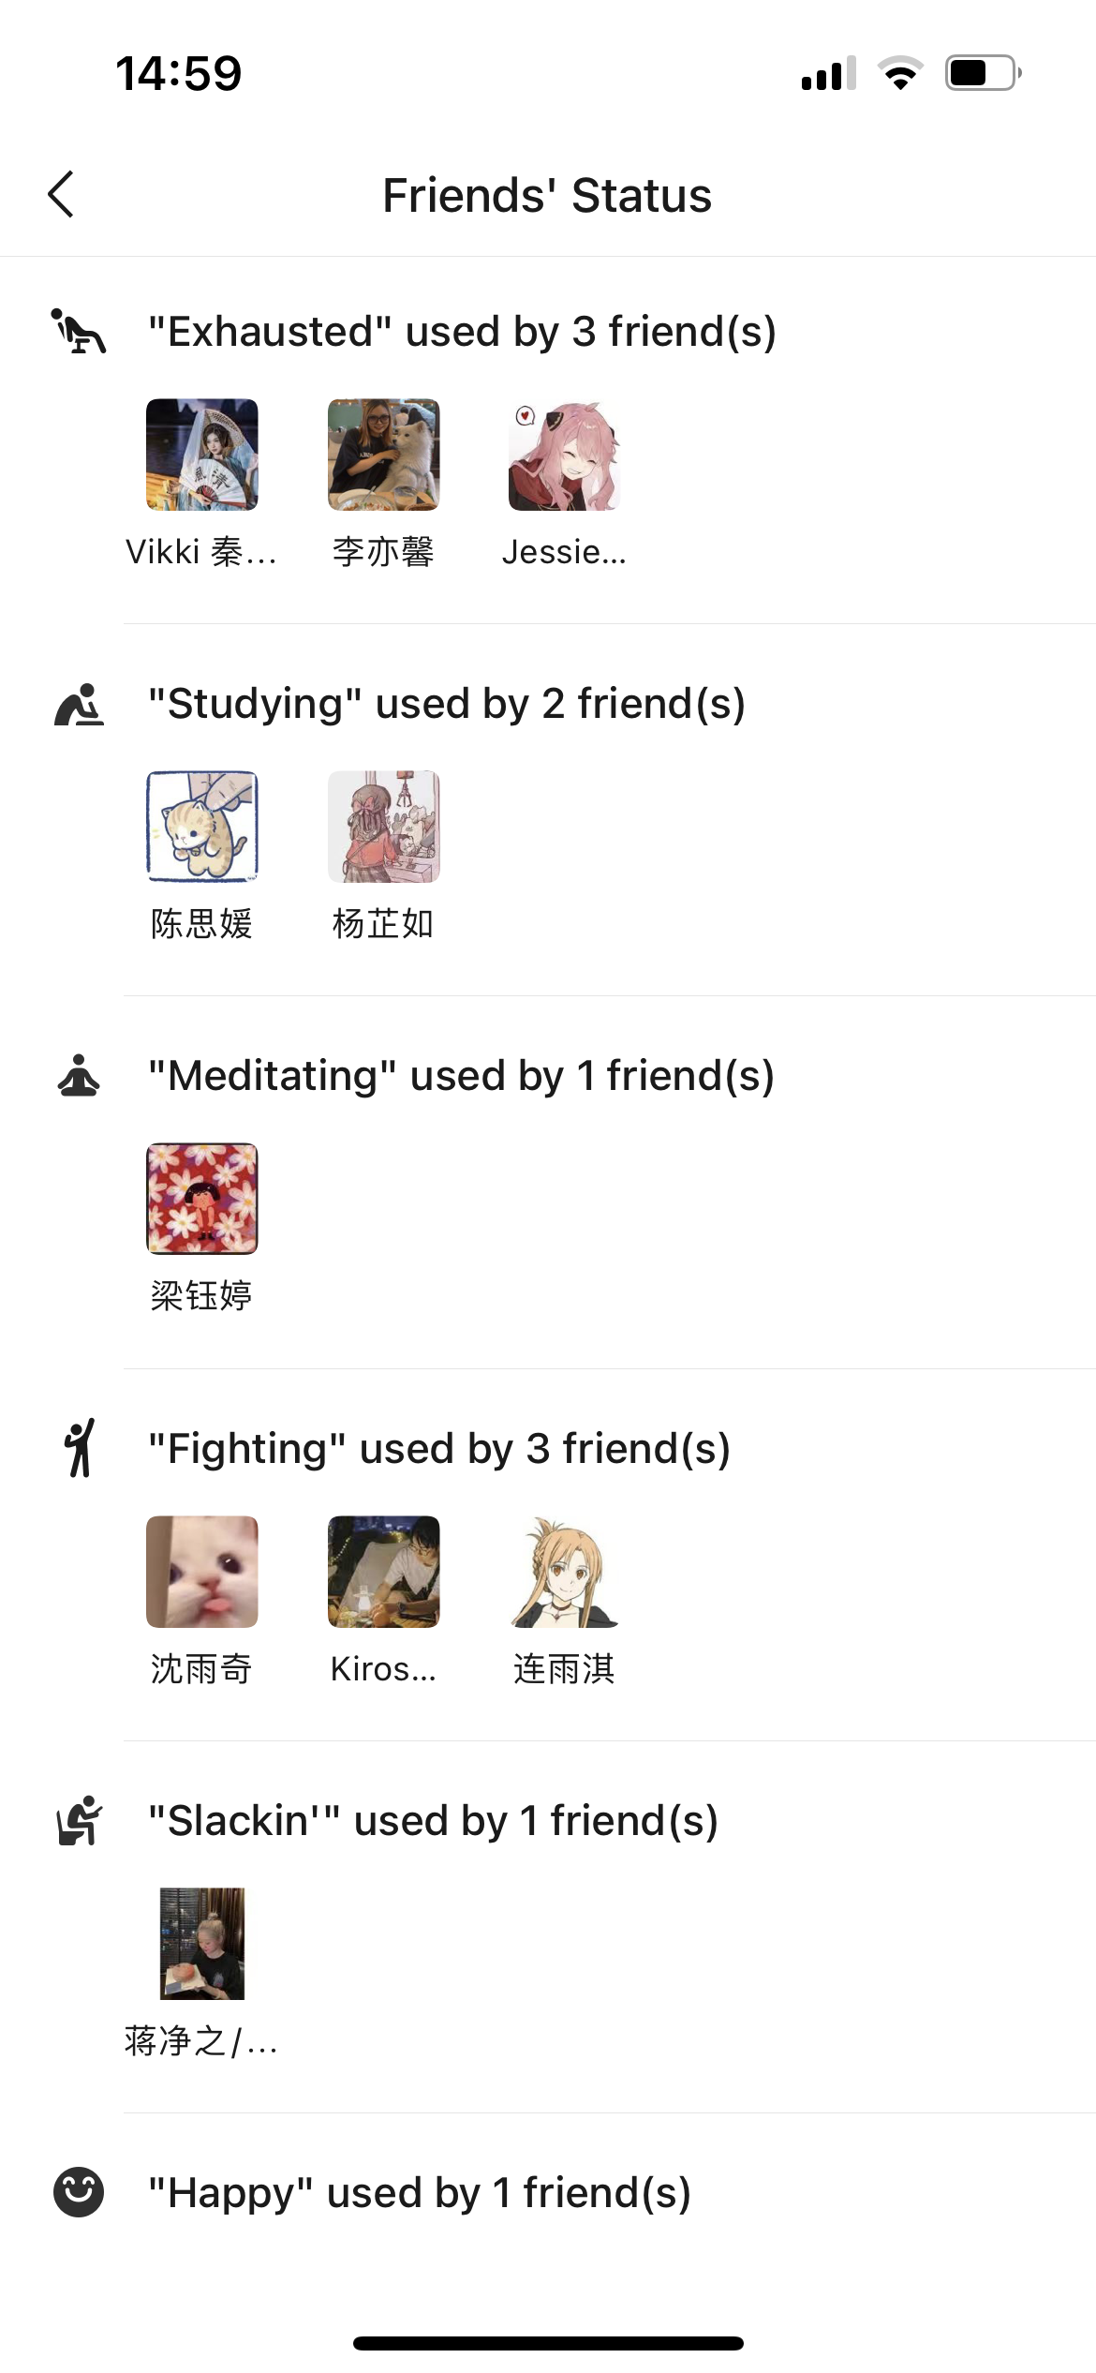


Literature Review: MarkerClock vs WeChat
Riche and Mackay (2009) highlighted the importance of "awareness system": being aware of one another’s routines, rhythms and status in order to maintain relationships.
MarkerClock (2009)
Awareness System...
GOOD IDEA !

Slide 10
Methodology
Various HCI evaluation methods were applied.
All studies were conducted in Guangzhou during 2022.
Domestic travel restrictions limited cross-provincial study;
Guangzhou, as a metropolitan, is more likely affected by Covid.
Method | Size | Time | Location
Cognitive Walkthrough | N=3 | October 16-17 | Guangzhou
Think Aloud | N=4 | October 23 | Guangzhou
Survey Questionnaire(s) | N=33; N=89 | October 1-31 | Guangzhou
Volunteer Experience | N/A | Whole year | Guangzhou

Slide 11
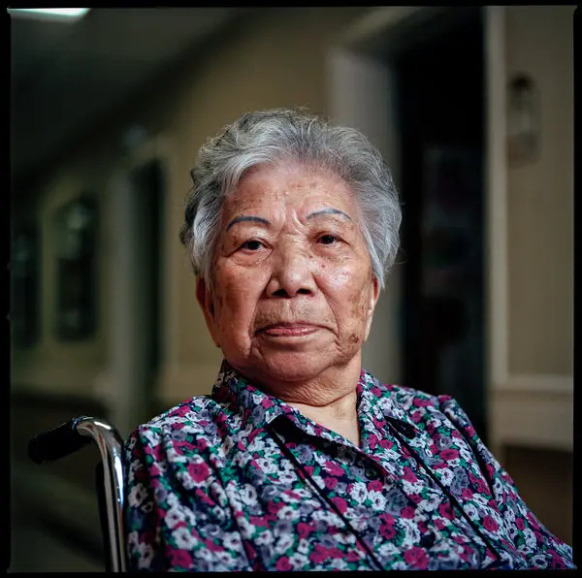

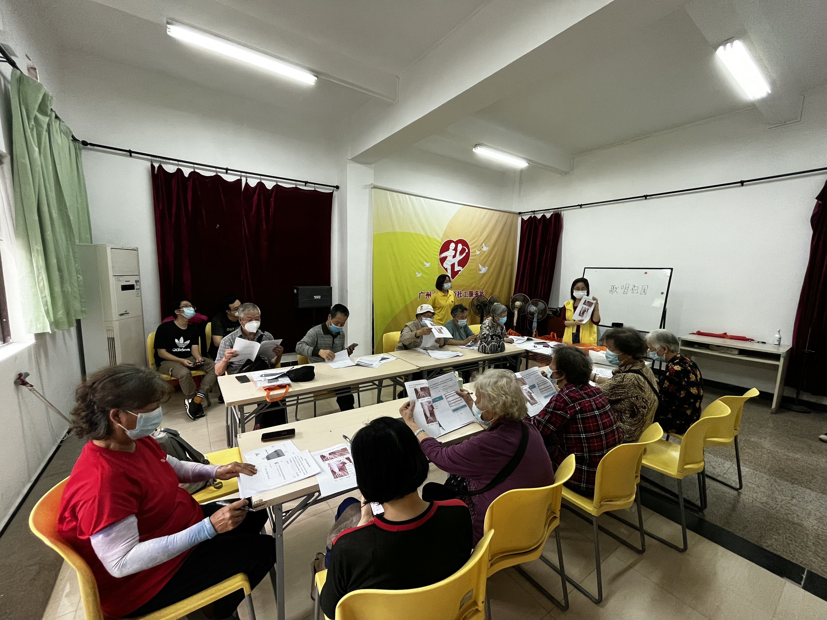
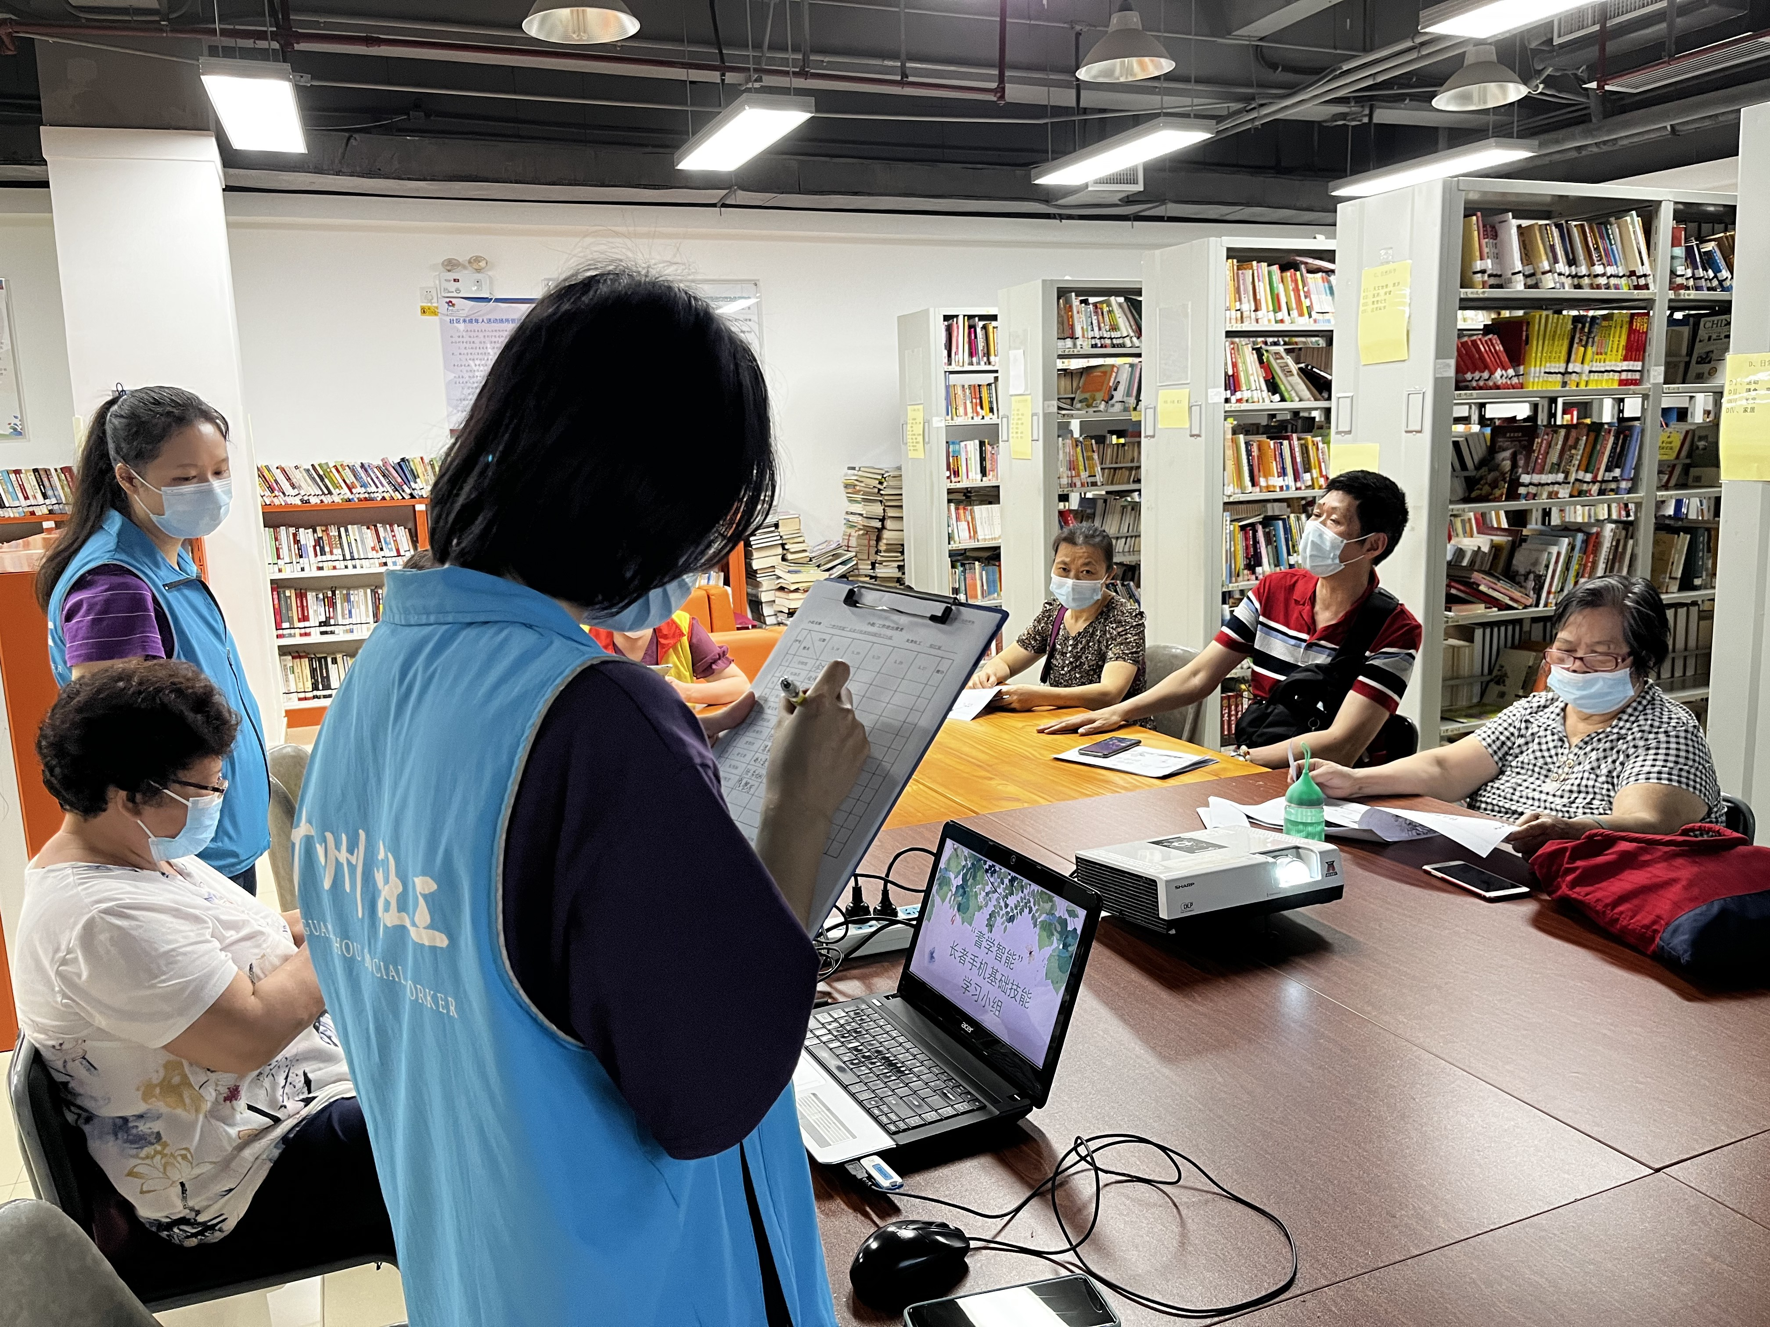
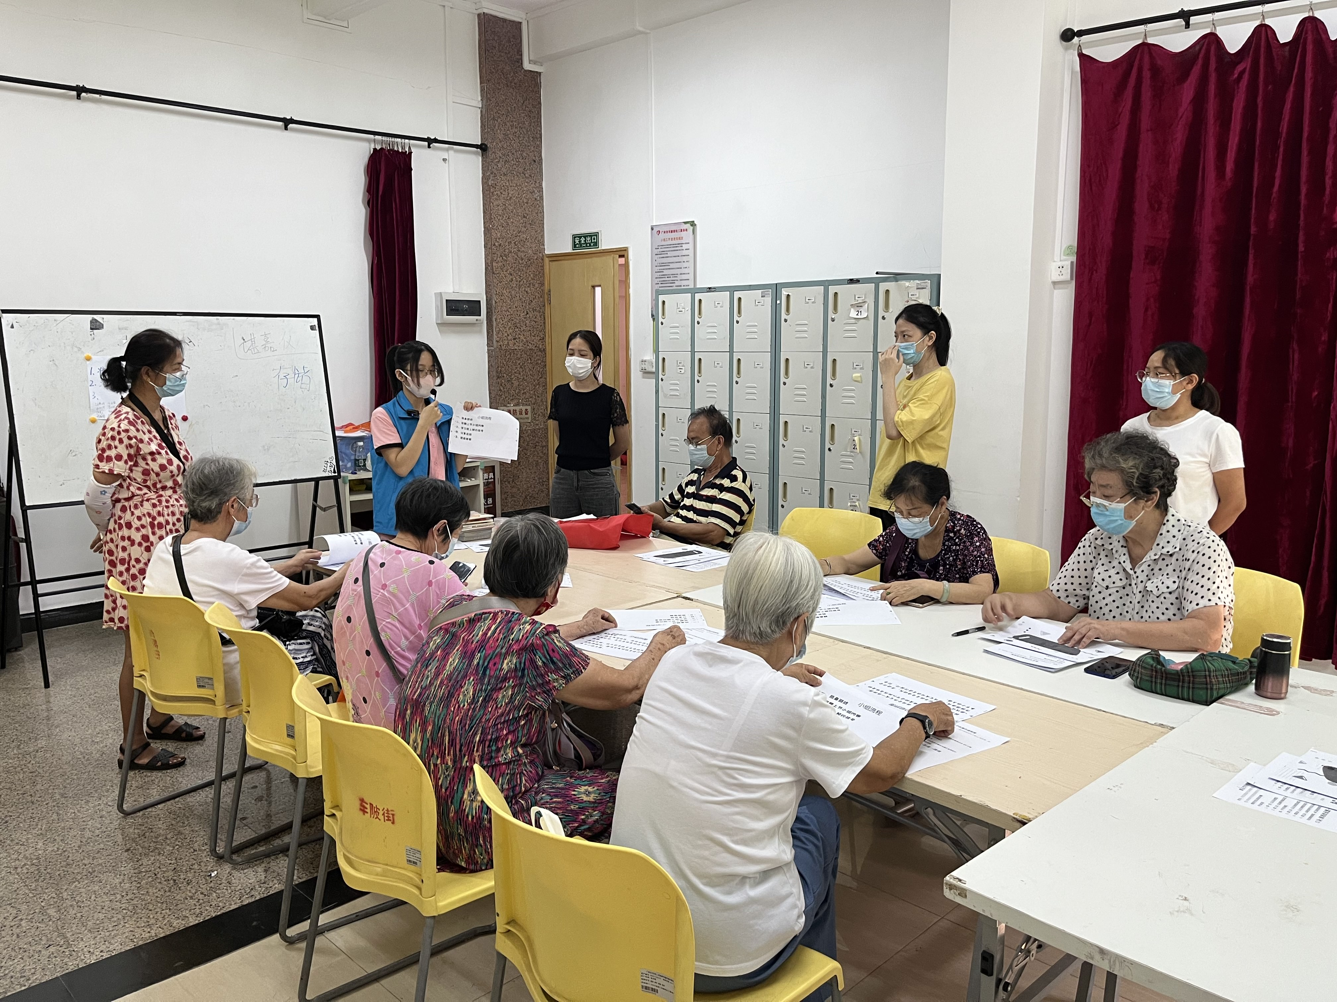
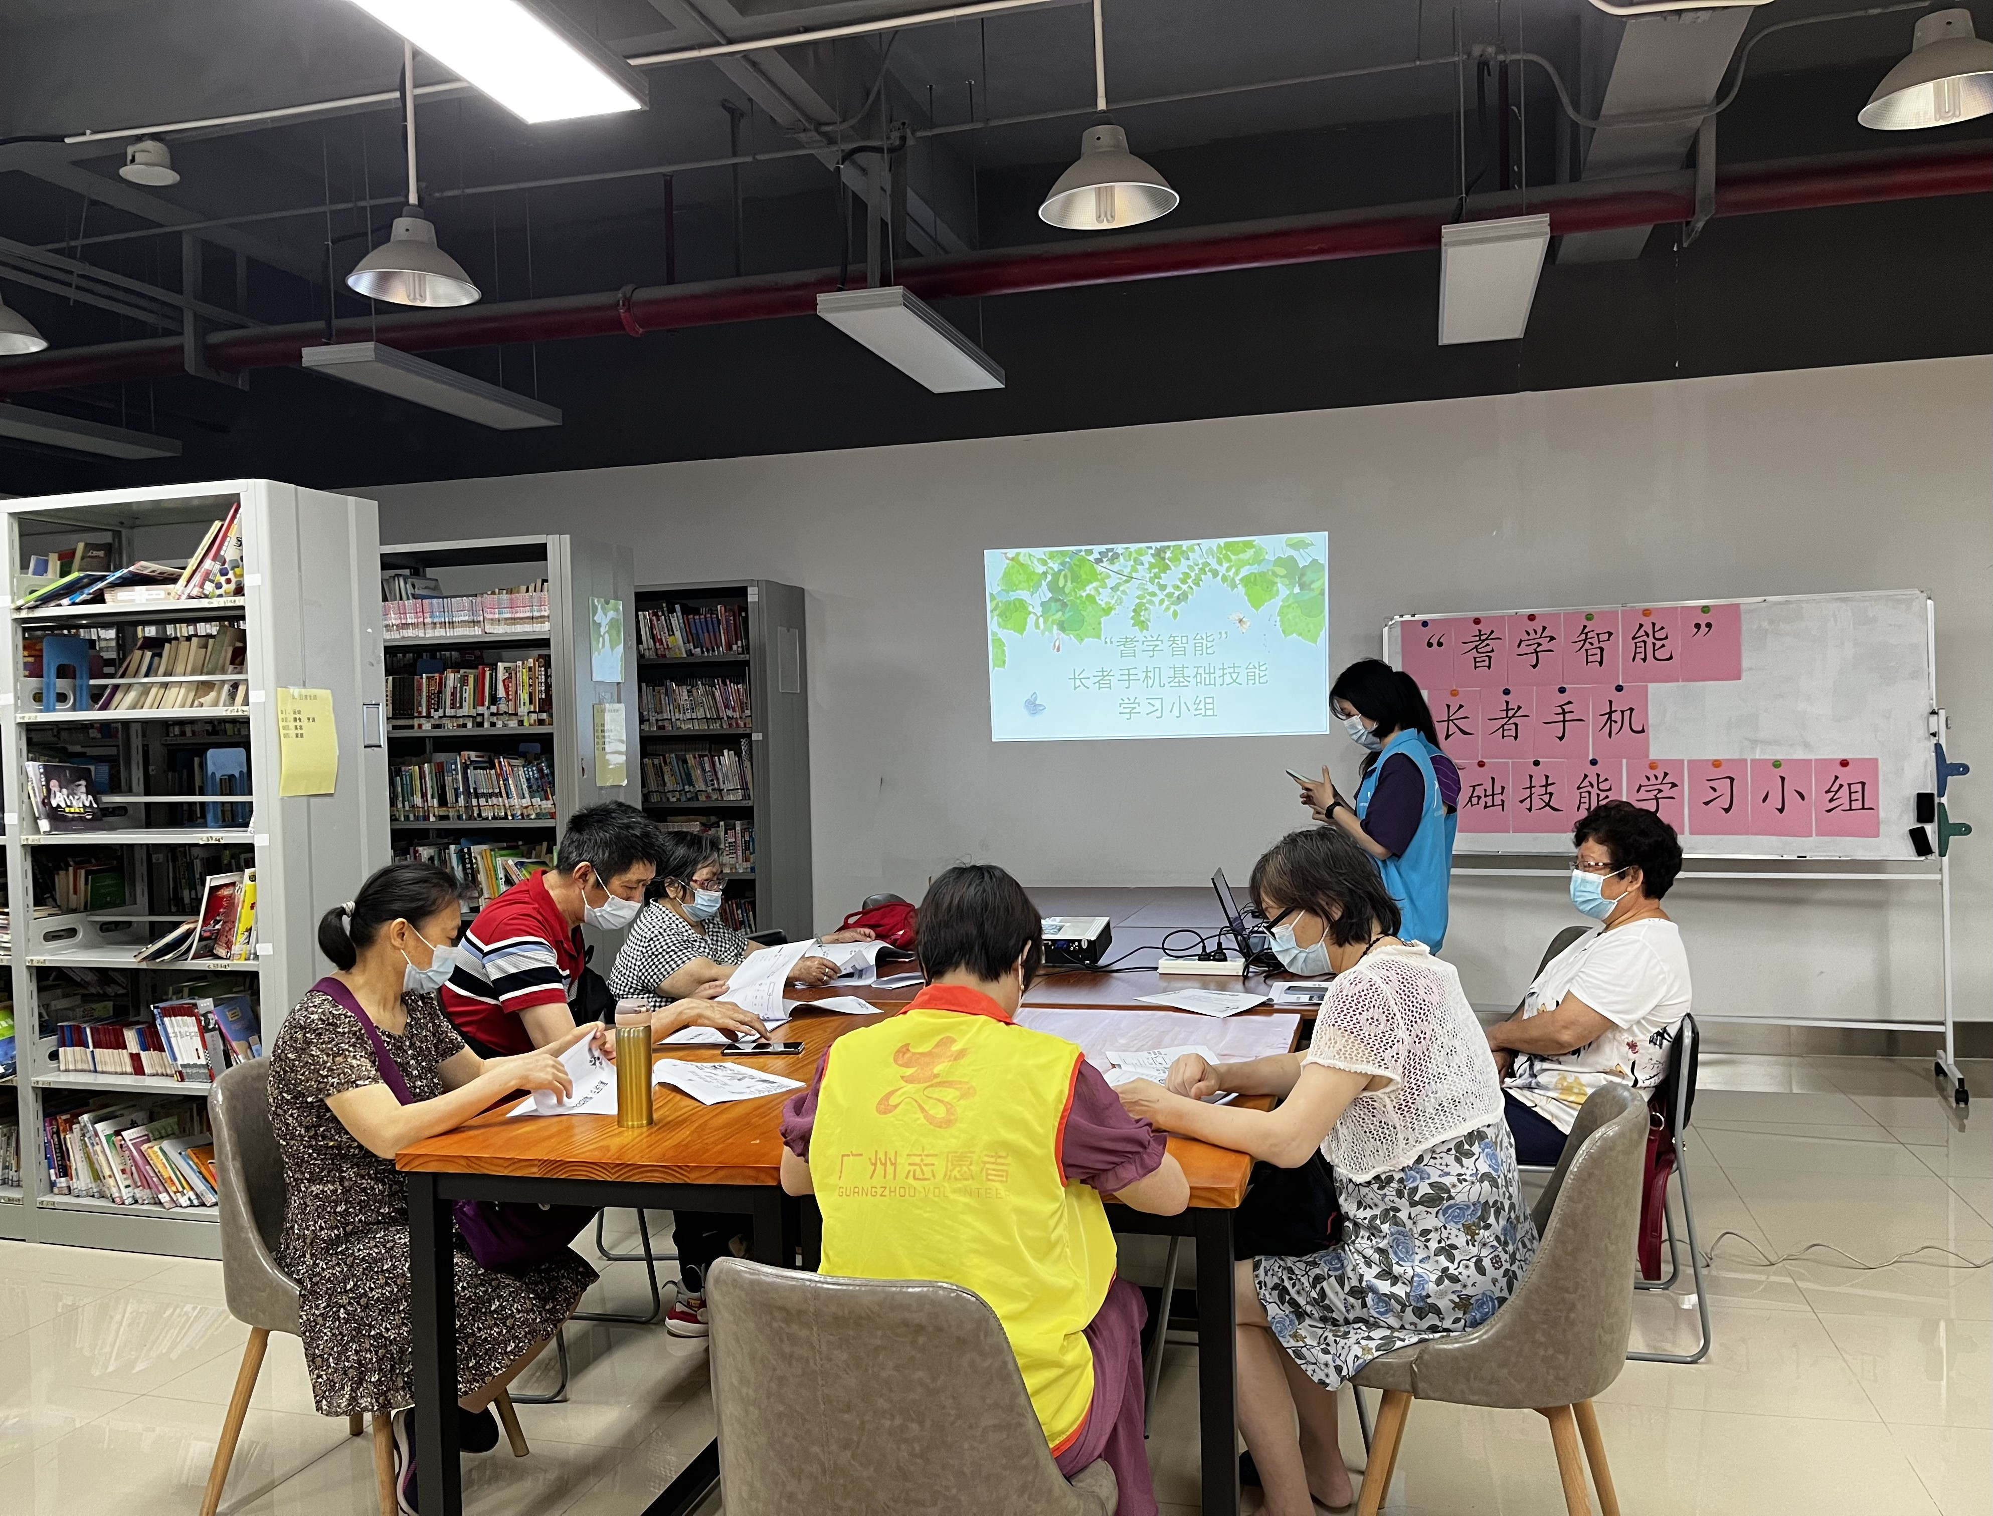
Methodology
Illustration of Methods
Persona
A: Ailing, 85, Female;
B: Baogang, 68, Male;
Reflect typical users;
Ideas are from reality.
Volunteer
Joined elderly smartphone classrooms hosted by service stations.
Is informal, only served as empirical, observational studies.

Slide 12
Methodology
Illustration of Methods
Cognitive Walkthrough
“Compact Cognitive Walkthrough” (CCW)
Decompose all user tasks into steps and experts evaluate by by asking:
“Would our persona know what to do at this step?”
“If the persona does the right action, do they know they have made progress toward their goal?”
Think Aloud
User Tasks done by elders.
UMUX-lite and Open Questions at the end.
Questionnaire
Preliminary Questionnaire.
WeChat Usability Questionnaire.

Slide 13
Results: Think Aloud
“Think Aloud” is THE usability testing method.
Information | Age | Gender | WeChat Literacy | Mobile Sysyem | Persona
P1(B) | 85 | M | Low | Apple | Baogang
P2(A) | 83 | F | Medium | Huawei | Ailing
P3(B) | 90 | M | None | Huawei | Baogang
P4(A) | 87 | F | Low | Huawei | Ailing
Result | Task A-01 | Task A-02 | Task A-03 | Task A-04 | Task B-05 | Task B-06 | Task C-07 | Task C-08 | Task D-09 | Task D-10
P1(B) | Yes | Yes | Yes | No | Yes | Yes | Yes | Yes | No | Help
P2(A) | Yes | Yes | Yes | Help | Yes | Yes | Yes | Yes | Yes | Help
P3(B) | No | No | No | No | No | No | No | No | No | No
P4(A) | Help | Yes | Yes | No | Help | No | Yes | Yes | Help | Help
Think Aloud Result Table

Slide 14
Results: Think Aloud
“Think Aloud” is THE usability testing method.
“Minimize window” during a video call.
“Share location” related functions.
Result | Task A-01 | Task A-02 | Task A-03 | Task A-04 | Task B-05 | Task B-06 | Task C-07 | Task C-08 | Task D-09 | Task D-10
P1(B) | Yes | Yes | Yes | No | Yes | Yes | Yes | Yes | No | Help
P2(A) | Yes | Yes | Yes | Help | Yes | Yes | Yes | Yes | Yes | Help
P3(B) | No | No | No | No | No | No | No | No | No | No
P4(A) | Help | Yes | Yes | No | Help | No | Yes | Yes | Help | Help
Think Aloud Result Table

Slide 15
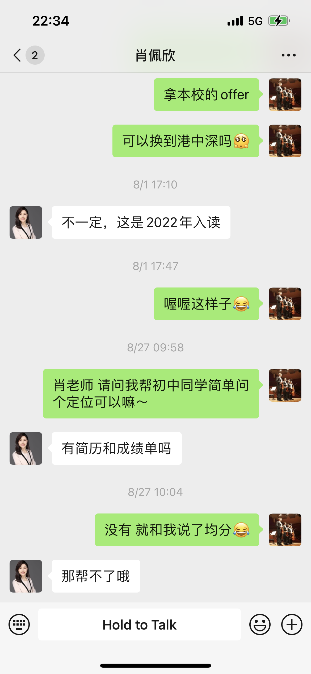
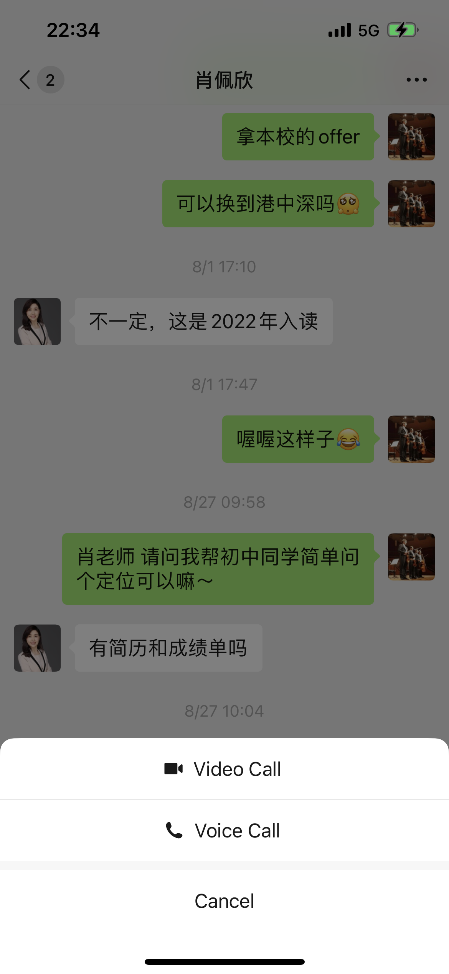
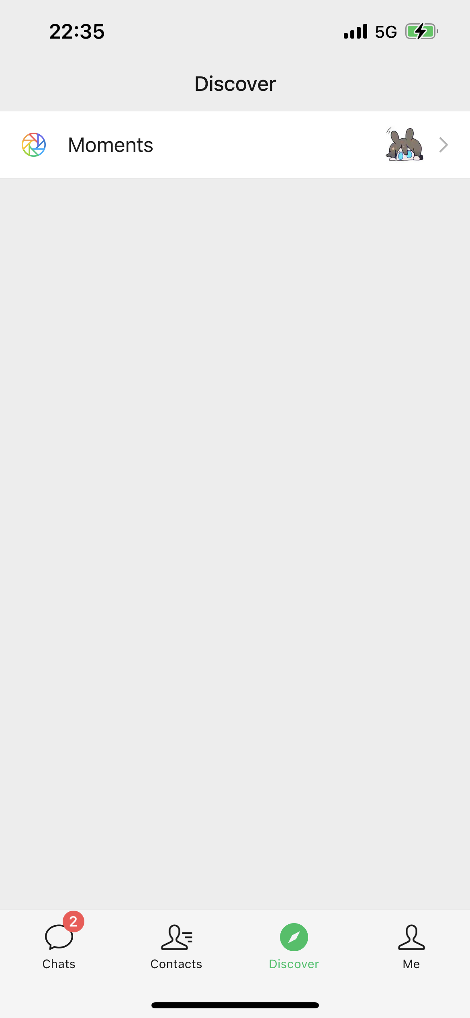
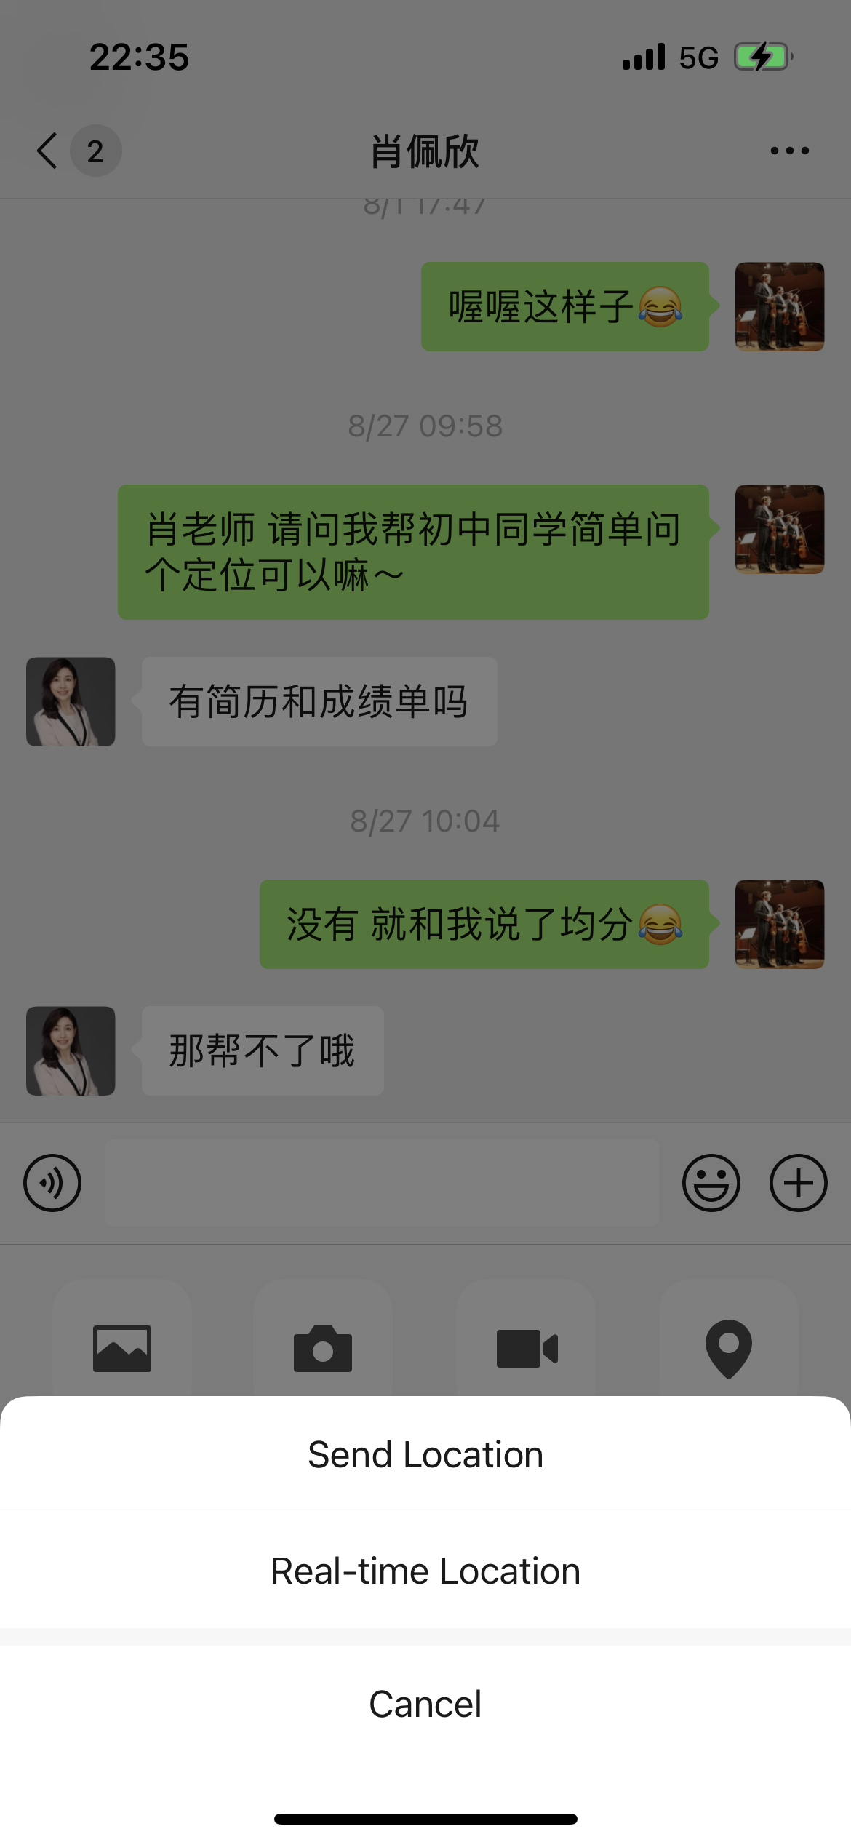
Results: WeChat Usability Questionnaire
Which comm.-related functionality is easiest to use?
 | Hold to Talk | Voice Call | Moments | Video Call | Location Share
Rank | No.1 | No.2 | No.3 | No.4 | No.5
Mean | 3.75 | 3.69 | 3.61 | 3.59 | 3.17
Median | 4.00 | 4.00 | 4.00 | 4.00 | 3.00
Stdiv. | 1.01 | 0.96 | 0.86 | 0.95 | 1.01
Notes:
The results of such think aloud studies could also be validated in the WeChat Usability Questionnaire, as we can see, “Location Share”is one of the least used functionnality in WeChat that is related to communications, partially due to its poor usability.

Slide 16
Results: WeChat Usability Questionnaire
Which comm.-related functionality is easiest to use?
HIDDEN
Demo of “Hold to Talk”

Slide 17
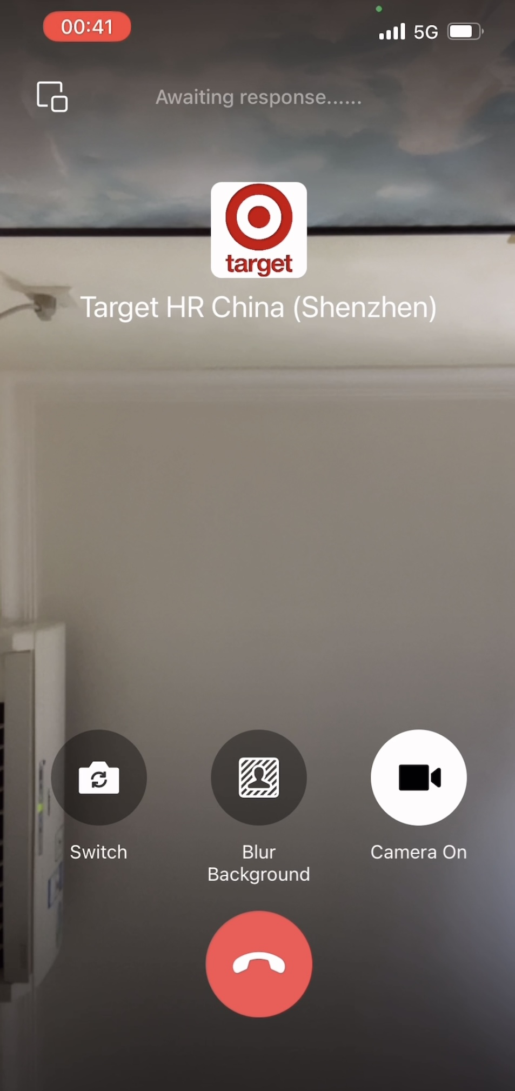
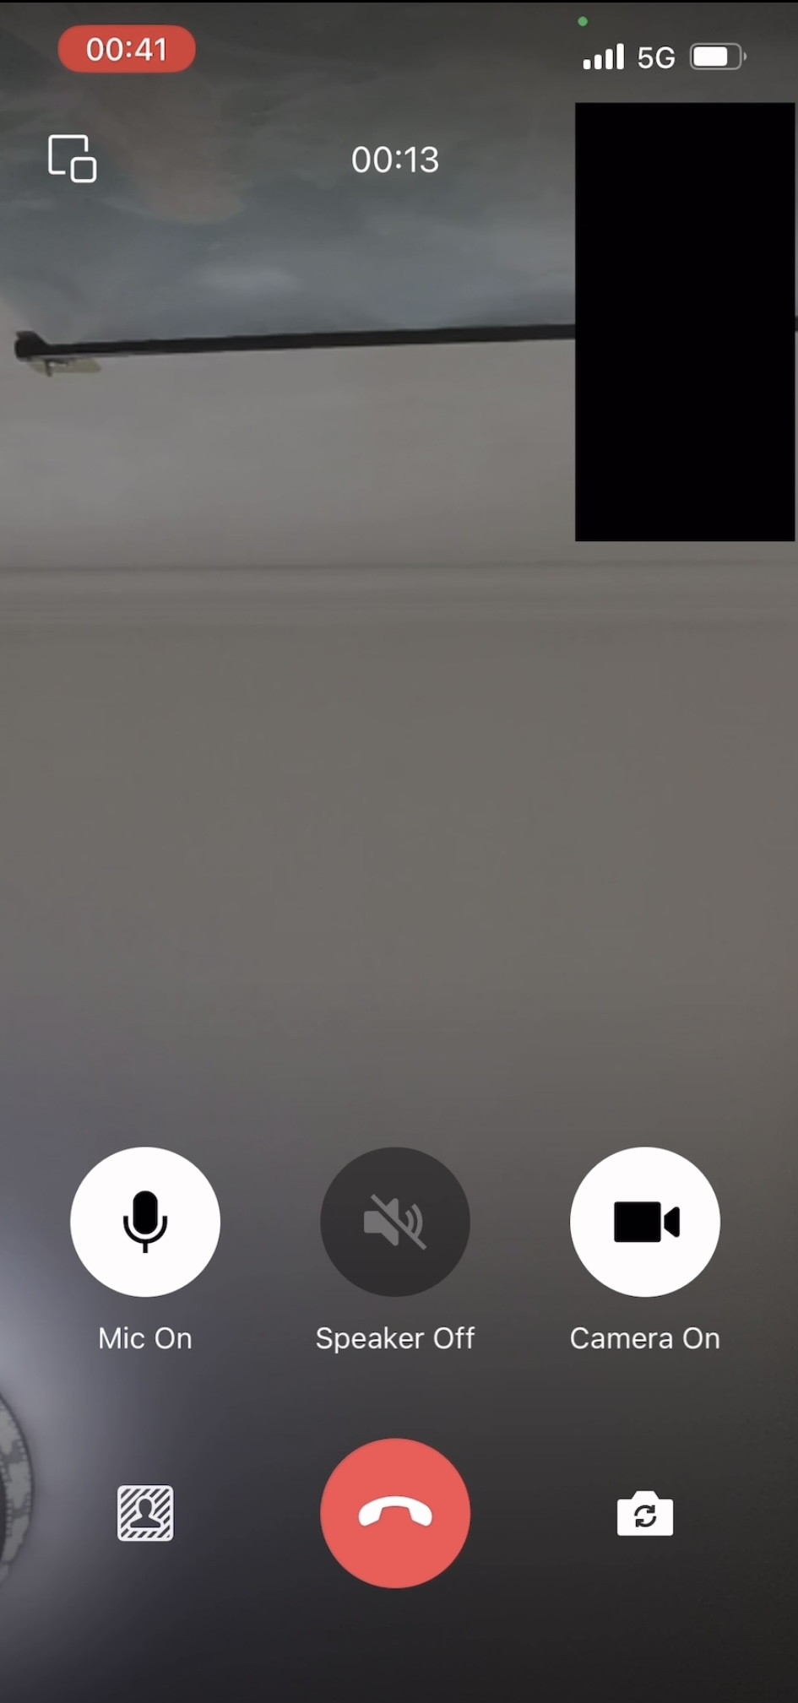
Results: Cognitive Walkthrough
Used “Compact Cognitive Walkthrough” (CCW) here.
Combined with Think Aloud, we discovered many issues:
• “Switch Camera” icon’s location is inconsistent during a call;
Before connection
After connection
Violated Nielsen’s heuristic of consistency!

Slide 18
Results: Cognitive Walkthrough
Used “Compact Cognitive Walkthrough” (CCW) here.
Combined with Think Aloud, we discovered many issues:
• “Switch Camera” icon’s location is inconsistent during a call;
• The wording of “Voice Call” procedure is incomprehensible;
• “Minimize Window” icon is invisible;
• The keyboard won’t appear unless touching white space;
• Hidden actions like double touch or long press, are less known;
• Functionalities in “...” and “+” are less used;
• Location sharing is less used and poor in usability.

Slide 19
Contribution
Raised hypothesis on WeChat and provided answers in descriptive statistics;
Reviewed past academic projects and analysed their functionality link with WeChat;
Designed an original questionnaire on WeChat usability for elders;
Evaluated WeChat usability via HCI methods (think aloud and cognitive walkthrough);
Redesigned elements of WeChat to make it easier to use for elders.

Slide 20
Limitation and Future Work
Selection bias
All based in Guangzhou
All during October, 2022
No co-design
Built on existing models
Elders analysed, no design
Hawthorn effect
Acquire better data
Expand sample coverage
Extend research cycle
Open design workshops
Invite hardware experts
Elders join design processes
Be careful on wording

Slide 21
Thanks for listening!
Changhao Li
School of Computer Science
University of Sydney

